Slide 1

Object Oriented Programming
CSE-0613-2203
Md. Riadul Islam
Assistant Professor
Dept. of Computer Science and Engineering(CSE)
University of Global Village (UGV)

Slide 2
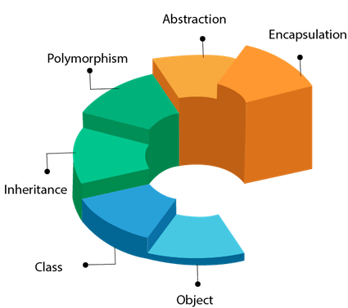
Basic Concepts Of Objects Oriented Programming week-1

Slide 3
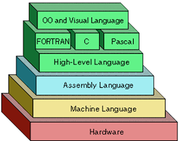
Introduction
Programmers write instructions in various programming languages to perform their computation tasks such as:
Machine level Language
Assembly level Language
High level Language

Slide 4
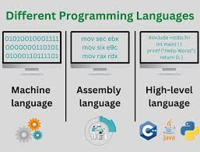
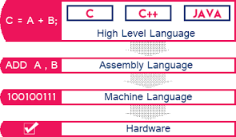
Introduction cont.

Slide 5
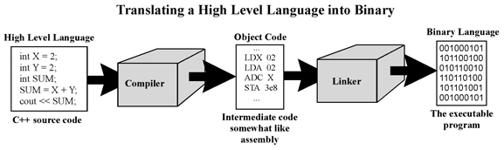
Introduction cont.

Slide 6
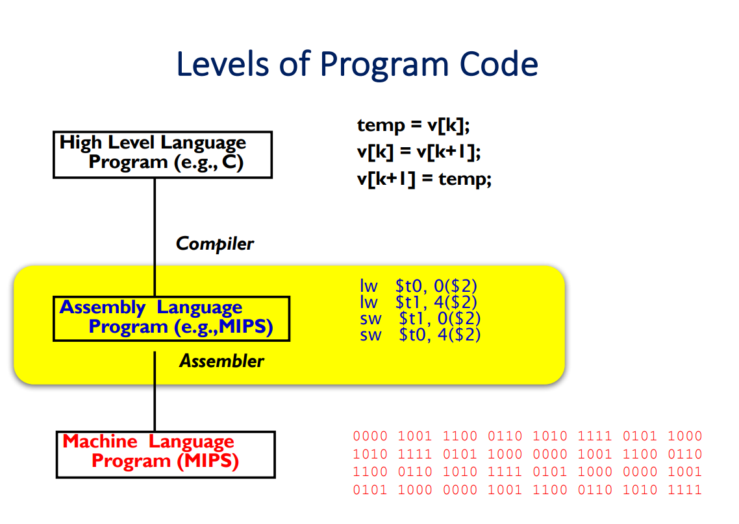
Introduction cont.
Assembly Language is the interface between higher level languages (C++, Java, etc) and machine code (binary).
For a compiled language, the compiler transforms higher level code into assembly language code.

Slide 7
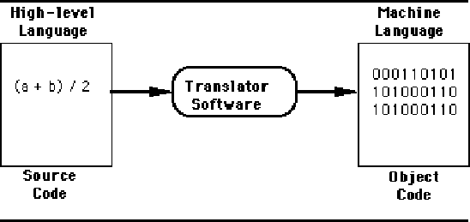
Machine level Language
Machine code or machine language is a set of instructions executed directly by a computer's central processing unit (CPU).
instruction performs a very specific task, such as a load, a jump, or an ALU operation on a unit of data in a CPU register or memory.
Every program directly executed by a CPU is made up of a series of such instructions.

Slide 8
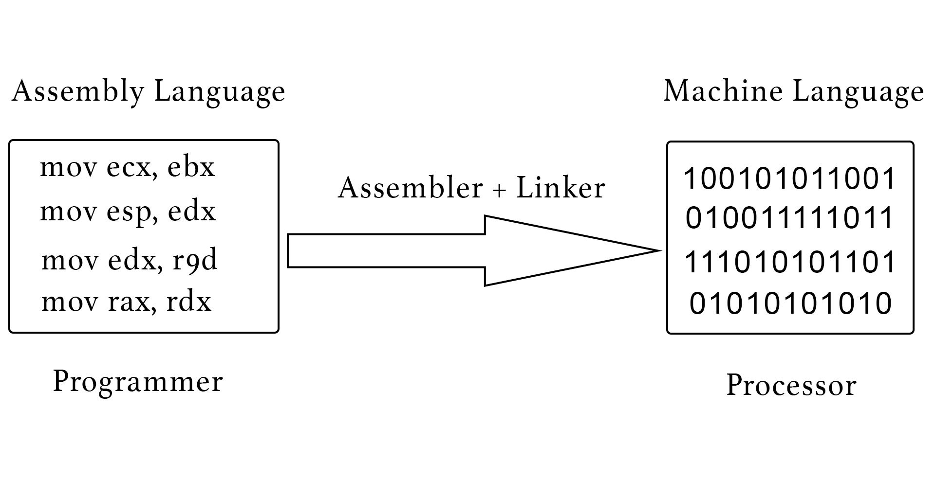
Assembly level Language
An assembly language (or assembler language) is a low-level programming language for a computer, or other programmable device, in which there is a very strong (generally one-to-one) correspondence between the language and the architecture's machine code instructions.
Assembly language is converted into executable machine code by a utility program referred to as an assembler; the conversion process is referred to as assembly, or assembling the code.

Slide 9

High level Language
High-level language is any programming language that enables development of a program in much simpler programming context and is generally independent of the computer's hardware architecture.

Slide 10
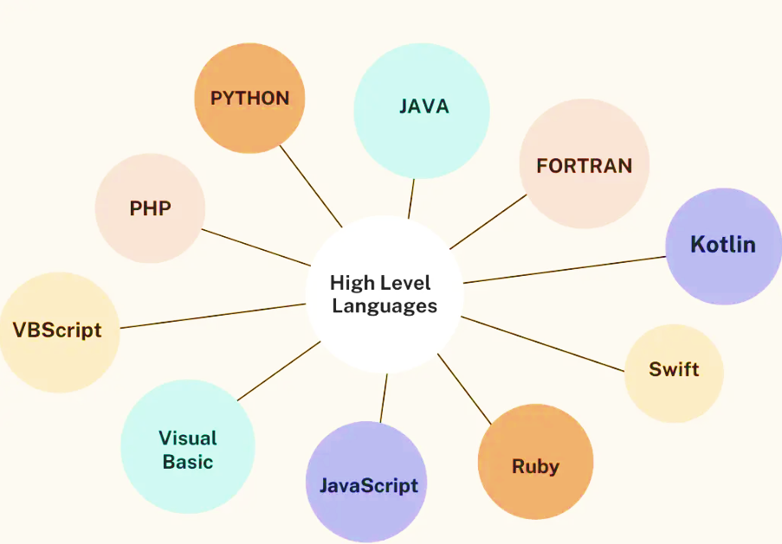
High level Language
High-level language has a higher level of abstraction from the computer, and focuses more on the programming logic rather than the underlying hardware components such as memory addressing and register utilization.
The first high-level programming languages were designed in the 1950s. Now there are dozens of different languages, including Ada , Algol, BASIC, COBOL, C, C++, JAVA, FORTRAN, LISP, Pascal, and Prolog.

Slide 11
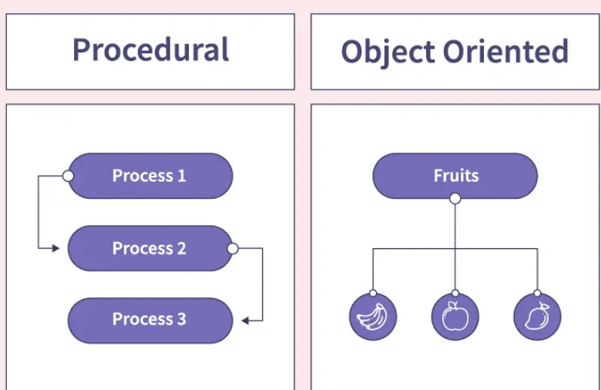
High level Language
The high-level programming languages are broadly categorized in to two categories:
Procedure oriented programming(POP) language.
Object oriented programming(OOP) language.

Slide 12
Procedure oriented programming(POP) language

Slide 13

Procedure Oriented Programming Language
In the procedure oriented approach, the problem is viewed as sequence of things to be done such as reading , calculation and printing.
Procedure oriented programming basically consist of writing a list of instruction or actions for the computer to follow and organizing these instruction into groups known as functions.

Slide 14
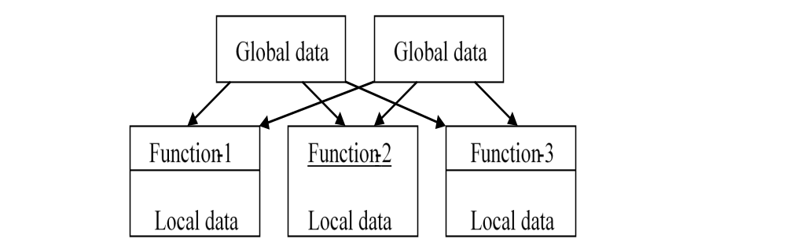
Procedure Oriented Programming Language
The disadvantage of the procedure oriented programming languages is:
Global data access
It does not model real word problem very well
No data hiding

Slide 15
Characteristics of procedure oriented programming
Emphasis is on doing things(algorithm)
Large programs are divided into smaller programs known as functions.
Most of the functions share global data
Data move openly around the system from function to function
Function transforms data from one form to another.
Employs top-down approach in program design

Slide 16
Object oriented programming(OOP) language

Slide 17
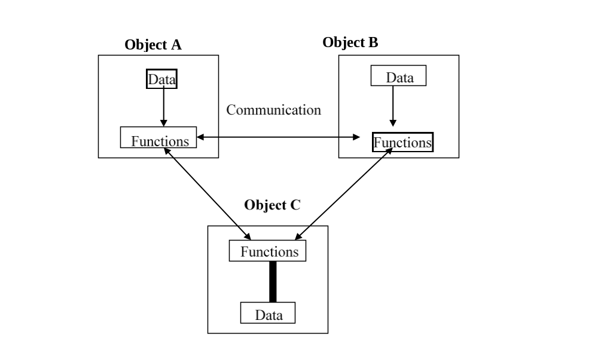
Object oriented programming(OOP) language
“Object oriented programming as an approach that provides a way of modularizing programs by creating partitioned memory area for both data and functions that can be used as templates for creating copies of such modules on demand”.

Slide 18
Features of the Object Oriented programming
Features of the Object Oriented programming
Emphasis is on doing rather than procedure.
programs are divided into what are known as objects.
Data structures are designed such that they characterize the objects.
Functions that operate on the data of an object are tied together in the data structure.
Data is hidden and can’t be accessed by external functions.
Objects may communicate with each other through functions.
New data and functions can be easily added.
Follows bottom-up approach in program design.

Slide 19
Basic Concepts Of OOP

Slide 20
Basic Concepts Of OOP
Objects
Classes
Data abstraction and encapsulation
Inheritance
Polymorphism
Dynamic binding
Message passing

Slide 21
Objects
Objects
Objects are the basic run-time entities in an object-oriented system. They may represent a person, a place, a bank account, a table of data or any item that the program must handle.
The fundamental idea behind object oriented approach is to combine both data and function into a single unit and these units are called objects.

Slide 22
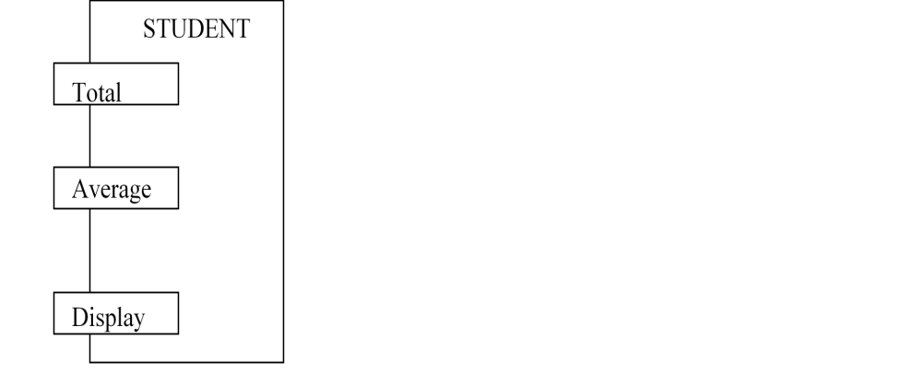

Objects
The term objects means a combination of data and program that represent some real word entity.
The program part of the object may be collection of programs
In general even any user –defined type-such as employee may be used.

Slide 23
Classes
Class:
A group of objects that share common properties for data part and some program part are collectively called as class.
In C ++ a class is a new data type that contains member variables and member functions that operate on the variables.

Slide 24
Data Abstraction
Data Abstraction :
Abstraction refers to the act of representing essential features without including the back ground details or explanations.
Classes use the concept of abstraction and are defined as size, width and cost and functions to operate on the attributes.

Slide 25
Data Encapsulation
Data Encapsulation :
The wrapping up of data and function into a single unit (called class) is known as encapsulation.
The data is not accessible to the outside world and only those functions which are wrapped in the class can access it.
These functions provide the interface between the objects data and the program.

Slide 26
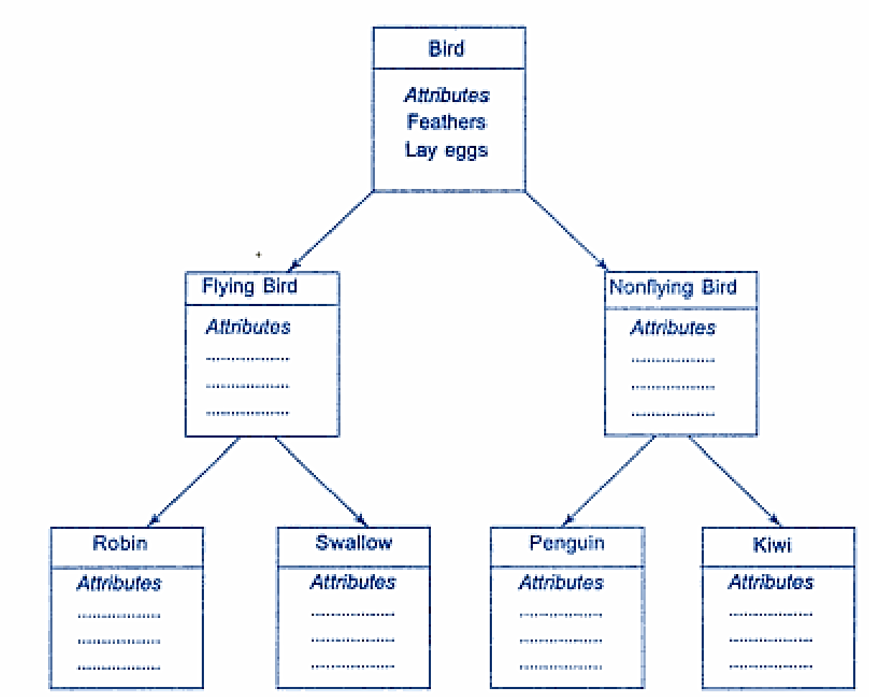
Inheritance
Inheritance is the process by which objects of one class acquire the properties of another class.
In the concept of inheritance provides the idea of reusability.
This mean that we can add additional features to an existing class with out modifying it.
This is possible by designing a new class will have the combined features of both the classes.

Slide 27
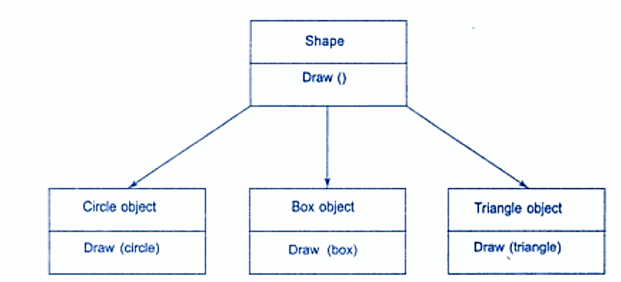
Polymorphism
Polymorphism means the ability to take more than one form. An operation may exhibit different instance. The behaviour depends upon the type of data used in the operation.
A language feature that allows a function or operator to be given more than one definition. The types of the arguments with which the function or operator is called determines which definition will be used.
Overloading may be operator overloading or function overloading.

Slide 28
Dynamic binding
Dynamic binding :
Binding refers to the linking of a procedure call to the code to the executed in response to the call.
Dynamic binding means the code associated with a given procedure call is not known untill the time of the call at run-time.
It is associated with a polymorphic reference depends upon the dynamic type of that reference.

Slide 29
Message Passing
Message passing :
An object oriented program consists of a set of objects that communicate with each other.
A message for an object is a request for execution of a procedure and therefore will invoke a function (procedure) in the receiving object that generates the desired result.
Message passing involves specifying the name of the object, the name of the function (message) and information to be sent.

Slide 30
Benefits of OOP
Benefits of OOP:
OOP offers several benefits to both the program designer and the user. Object-oriented contributes to the solution of many problems associated with the development and quality of software products. The principal advantages are :
Through inheritance we can eliminate redundant code and extend the use of existing classes.
We can build programs from the standard working modules that communicate with one another, rather than having to start writing the code from scratch. This leads to saving of development time and higher productivity.
This principle of data hiding helps the programmer to build secure programs that can’t be invaded by code in other parts of the program.

Slide 31
Benefits of OOP
It is possible to have multiple instances of an object to co-exist with out any interference.
It is easy to partition the work in a project based on objects.
Object-oriented systems can be easily upgraded from small to large systems.
Message passing techniques for communication between objects makes the interface description with external systems much simpler.
Software complexity can be easily managed.

Slide 32
Application of OOP
Application of oop:
The most popular application of oops up to now, has been in the area of user interface design such as windows. There are hundreds of windowing systems developed using OOP techniques.
Real business systems are often much more complex and contain many more objects with complicated attributes and methods. OOP is useful in this type of applications because it can simplify a complex problem.

Slide 33
Application of OOP
The promising areas for application of OOP includes.
Real – time systems.
Simulation and modeling
Object oriented databases.
Hypertext,hypermedia and expertext.
Al and expert systems.
Neural networks and parallel programming.
Dicision support and office automation systems.
Cim / cam / cad system.

Slide 34
Basics of C++ week-2

Slide 35
Basics of C++
C ++ is an object oriented programming language
C ++ was developed by Jarney Stroustrup at AT & T Bell lab, USA in early eighties.
C ++ was developed from c and simula 67 language.
C ++ was early called ‘C with classes’.

Slide 36
C++ Comments
C++ introduces a new comment symbol //(double slash).
Comments start with a double slash symbol and terminate at the end of line.
A comment may start any where in the line and what ever follows till the end of line is ignored.
Note that there is no closing symbol.
The double slash comment is basically a single line comment.
Multi line comments can be written as follows:
  /* this is an example of c++ program */

Slide 37


Program Style
Bottom-line: Make programs easy to read and modify,
Follow a consistent naming convention for variables, functions, and classes. Common conventions include:
  Camel Case: myVariableName
  Snake Case: my_variable_name
  Pascal Case: MyClassName
Proper comments help others (and yourself) understand your code.
Single-line comments
Multi-line comments

Slide 38
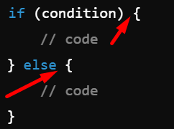
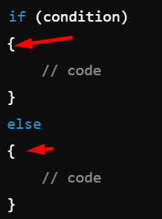
Program Style cont.
K&R Style
Indentation and Bracing Style Proper indentation and the placement of braces ({}) greatly enhance code readability. There are several widely used bracing styles in C++:
K&R Style (Kernighan and Ritchie): The opening brace is on the same line as the control statement, and the closing brace is aligned with the control statement.
Allman Style: Each brace is placed on its own line.
Allman Style

Slide 39
Program Style cont.
Use const wherever possible to indicate variables, parameters, and return types that should not change.
Use exceptions (try-catch blocks) or return error codes to handle errors gracefully.
Avoid the use of global variables to reduce coupling and potential side effects across different parts of your program.
Avoid code duplication by using functions, classes, or templates for reusable code.

Slide 40
Libraries
C++ Standard Libraries
#include <Library_Name>
  Directive to "add" contents of library file to
  your program
  Called "preprocessor directive"
    Executes before compiler, and simply "copies"
    library file into your program file
C++ has many libraries
  Input/output, math, strings, etc.

Slide 41
Namespaces
Namespaces defined:
  Collection of name definitions
For now: interested in namespace "std"
  Has all standard library definitions we need
Examples:
#include <iostream>
using namespace std;
    Includes entire standard library of name definitions
#include <iostream>using std::cin;
using std::cout;
    Can specify just the objects we want

Slide 42
Operators In C++
<< | insertion operator
>> | extraction operator
: : | scope resolution operator
: :* | pointer to member declarator
* | pointer to member operator
.* | pointer to member operator
Delete | memory release operator
Endl | line feed operator
New | memory allocation operator
Setw | field width operator
C++ has a rich set of operators.
All C operators are valid in C++ also.
C++ introduces some new operators.

Slide 43
Input and Output (I/O)
In C++, input and output (I/O) operations are performed using streams provided by the Standard Input/Output Library (iostream).
The two primary streams for input and output are:
cin: For input (standard input, typically from the keyboard).
cout: For output (standard output, typically to the console).

Slide 44
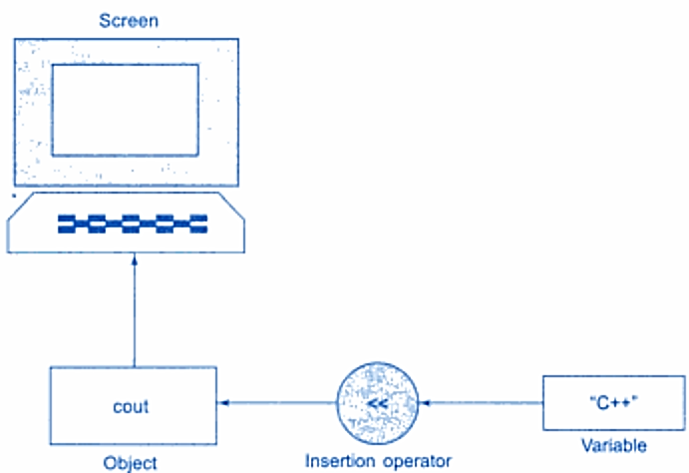

cout
In C++, cout (short for "console output") is used to output data to the standard output device, typically the console. It is part of the input/output stream provided by the <iostream> header.
How cout Works:
The cout object works with the insertion operator (<<) to send data to the output stream.
You can output various data types (integers, floating-point numbers, characters, strings, etc.) using cout.

Slide 45
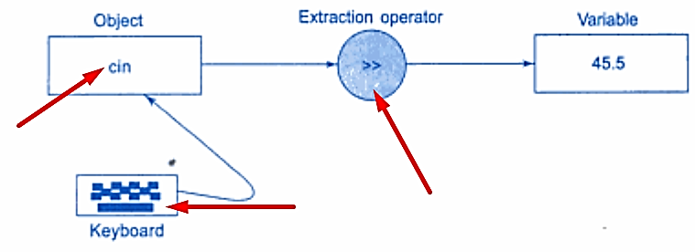

cin
In C++, cin (short for "console input") is used to receive input from the user through the keyboard. It is part of the standard input/output stream and is provided by the <iostream> header.
The cin object uses the extraction operator (>>) to read data from the input buffer and store it into a variable.
It automatically converts the input to the appropriate type based on the variable’s type.
cin ignores leading whitespace (spaces, tabs, and newlines) but stops reading when it encounters whitespace after the input (except for getline() when used for strings).

Slide 46
Cin Whitespace Handling
Whitespace Handling:
cin ignores leading whitespace (like spaces, tabs, and newlines).
For strings, cin reads only a single word until it encounters whitespace.
read a whole line, you should use getline().
Using getline() for Strings: If you want to input an entire line of text, including spaces, you need to use getline() instead of cin.
cin is a simple and commonly used way to handle user input in C++. It works well for various types of input, but for more complex cases like reading a full string with spaces, getline() is a better option.

Slide 47
Other I/O Manipulators
C++ provides several manipulators to control the formatting of input and output. Some common manipulators include:
setw(n): Sets the width of the output field.
setprecision(n): Sets the number of decimal places to display for floating-point numbers.
fixed: Forces output of floating-point numbers in fixed-point notation.
showpoint: Forces display of the decimal point and trailing zeros.
hex, oct, dec: Changes the base for numeric output to hexadecimal, octal, or decimal.

Slide 48
Tokens
The smallest individual units in program are known as tokens. C++ has the following
i. Keywords
ii. Identifiers
iii. Constants
iv. Strings
v. Operators

Slide 49
Keywords
The keywords implement specific C++ language feature.
They are explicitly reserved identifiers and can’t be used as names for the program variables or other user defined program elements.
The keywords not found in ANSI C are shown in red letter.

Slide 50
C++ Keywords:
asm | double | new | switch
auto | else | operator | template
break | enum | private | this
case | extern | protected | throw
catch | float | public | try
char | for | register | typedef
class | friend | return | union
const | goto | short | unsigned
continue | if | signed | virtual
default | inline | sizeof | void
delete | long | struet | while

Slide 51
Identifiers in C++
Identifiers in C++ are names used to identify variables, functions, classes, objects, and other user-defined items. They are critical for giving a meaningful name to a program entity. Here are some key rules and characteristics regarding identifiers in C++:
Allowed Characters: Identifiers can contain letters (both uppercase and lowercase), digits (The name can’t start with a digit), and underscores (_).
  Example: myVar, counter_1, sumTotal
Starting Character: An identifier must begin with a letter or an underscore (_), but not a digit.
  Valid: _myVar, sumTotal
  Invalid: 1counter, 2sum

Slide 52
Identifiers in C++
Case Sensitivity: Identifiers in C++ are case-sensitive.
  For example, myVar and MyVar would be considered different identifiers.
Keywords Restriction: Identifiers cannot be the same as any C++ keyword (such as int, class, while, etc.).
  Invalid: int, float, return
No Special Characters: Special characters like @, #, $, %, &, etc., are not allowed in identifiers.
  Invalid: my$Var, sum#Total

Slide 53
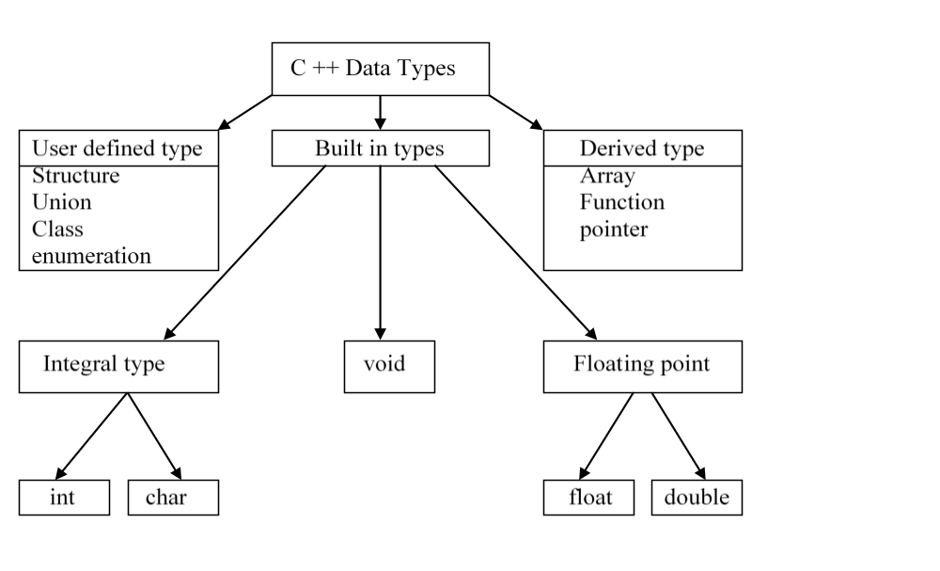
Data types in C++

Slide 54
Built-in Data Types

Slide 55
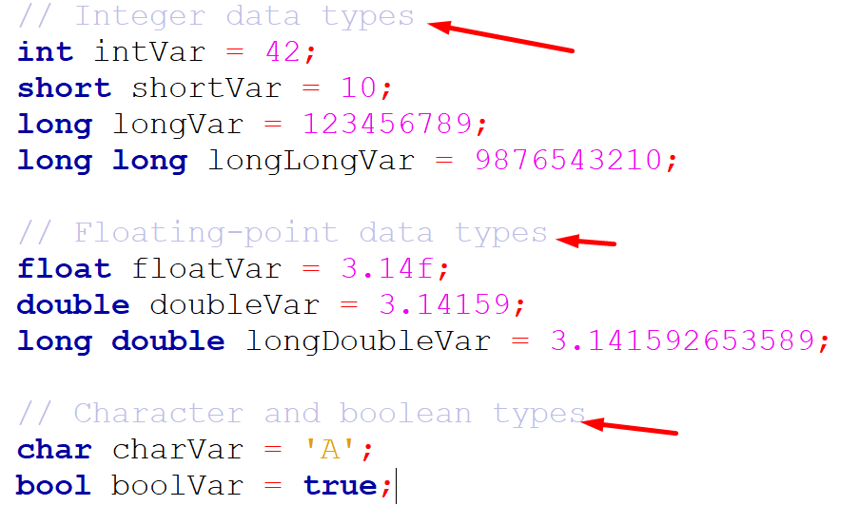
built-in data
These are the fundamental types of data, including
Integer types: int, short, long, long long
Floating-point types: float, double, long double
Character type: char
Boolean type: bool
Void type: void

Slide 56
User-Define Data Types week-3

Slide 57
Struct

Slide 58
Struct in C++
In C++, a structure (or struct) is a user-defined data type that allows grouping together different variables under a single name.
Unlike classes, structures in C++ default to public access for their members.
Key Points: Public by default:
  Unlike classes, members of a structure are public by default.
  Accessing members: Use the dot operator (.) to access structure members.
  Member functions: Structures can also have member functions just like classes.

Slide 59
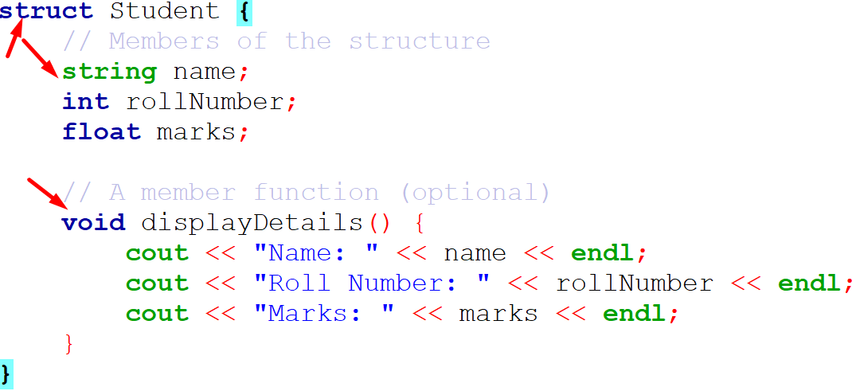
Struct in C++
Explanation:
The struct Student defines a structure with three members: name, rollNumber, and marks.
The displayDetails() function inside the structure is used to print the details of the student.
In the main() function, a Student object named student1 is created, and values are assigned to its members.

Slide 60
struct in C vs. C++:
Summary of struct in C vs. C++:
Feature | struct in C | struct in C++
Member functions | Not allowed | Allowed (just like in class)
Constructors/Destructors | Not allowed | Allowed
Inheritance | Not supported | Supported
Access specifiers | Not available (all members public) | Available (public by default)
Encapsulation | Not possible (no private members) | Possible (can define private members)
Polymorphism (Virtual Functions) | Not supported | Supported (like in class)

Slide 61
Union

Slide 62
Union in C++
In C++, a union is a special class type that allows storing different data types in the same memory location.
Unlike a struct, where each member has its own memory location, in a union, all members share the same memory location.
This means only one member can hold a value at any given time, and modifying one member will affect the others.
union unionName {
dataType1 member1;
dataType2 member2;};

Slide 63
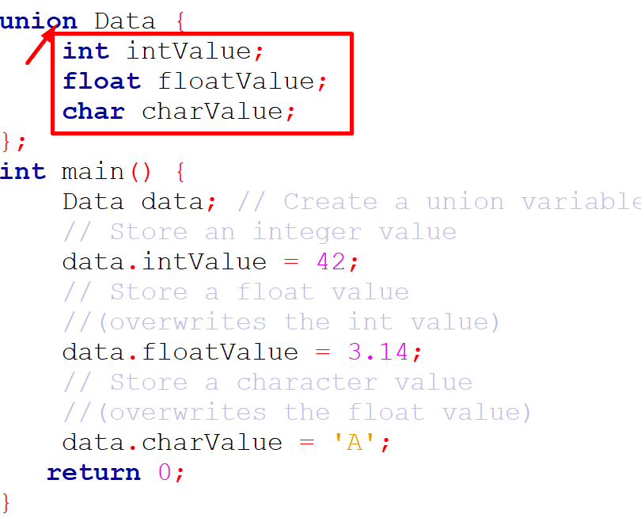
Union in C++

Slide 64
enumerated

Slide 65
enumerated
In C++, an enum (short for enumeration) is a user-defined data type that consists of integral constants.
You can use an enum to assign names to a set of values, which makes the code more readable and manageable.
Syntax:
enum enum_name { value1, value2, value3, ... };

Slide 66
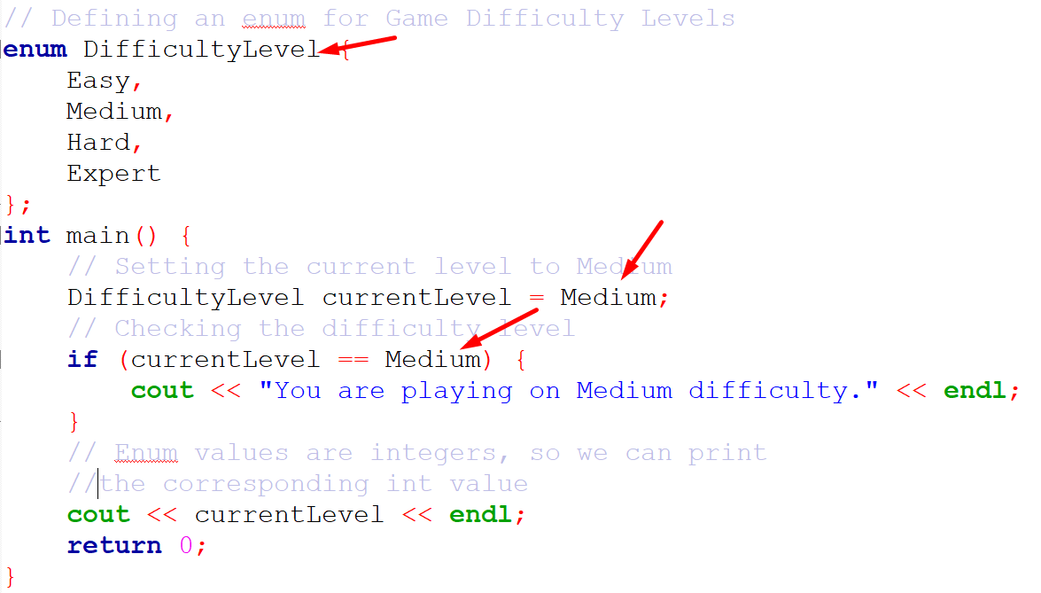
enumerated

Slide 67
enumerated
Explanation:
The enum DifficultyLevel has four values: Easy, Medium, Hard, and Expert.
By default, Easy is assigned the value 0, Medium is 1, Hard is 2, and Expert is 3.
In the main function, the variable currentLevel is assigned the value Medium.
When you print currentLevel, it will output 1 because Medium is the second item (starting from 0).

Slide 68
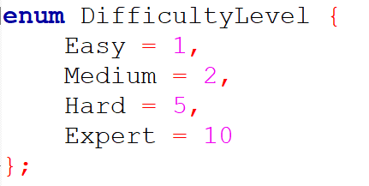
enumerated
Customizing Enum Values:
You can assign custom values to the enum constants if desired:

Slide 69
Drive Data Types week-4

Slide 70
Array

Slide 71
Array
An array in C++ is a collection of elements of the same data type, stored in contiguous memory locations.
Arrays are static, meaning their size must be specified at the time of declaration and cannot be changed.
Syntax for a 1D Array:
data_type array_name[array_size];

Slide 72
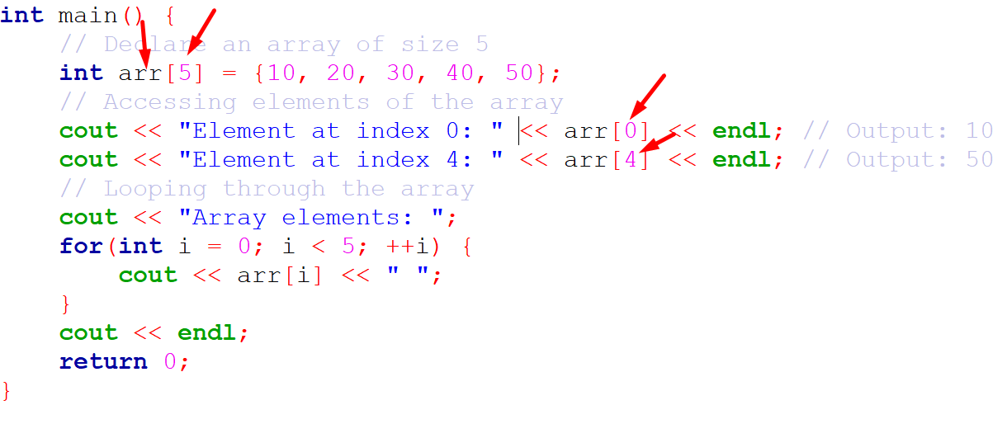
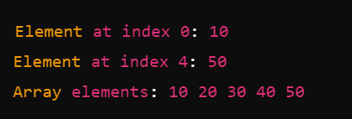
Array
Example of Declaring, Initializing, and Accessing an Array:
Output:

Slide 73
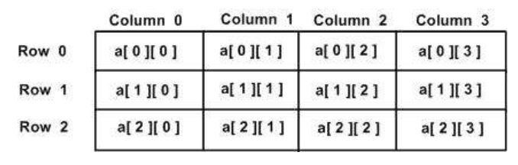
2d-Array
In C++, a 2D array is essentially an array of arrays.
You can define a 2D array with a specific number of rows and columns, and then access or manipulate its elements using two indices: one for the row and one for the column.
Syntax for a 2D Array:
data_type array_name[rows][columns];

Slide 74
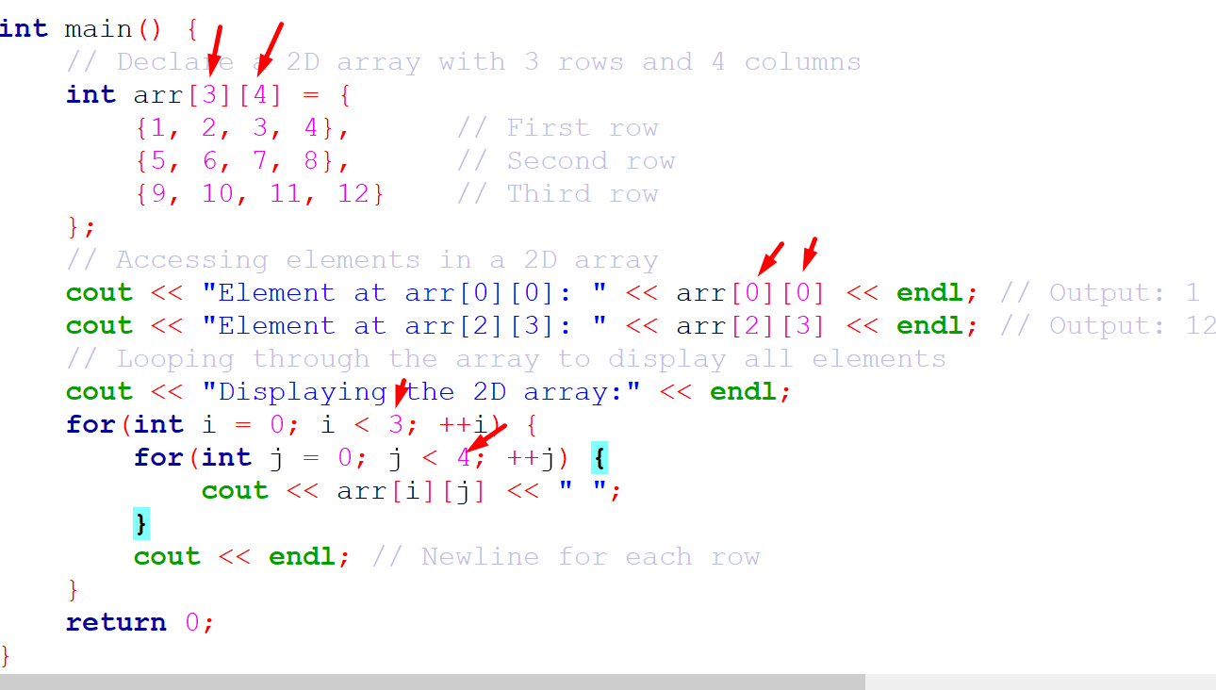
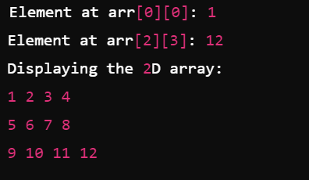
2d-Array
Output:

Slide 75
2d-Array
Explanation:
Declaration and Initialization: The 2D array arr[3][4] has 3 rows and 4 columns.
It is initialized with specific values.
Accessing Elements: arr[0][0] accesses the first element, and arr[2][3] accesses the last element of the array.
Looping: Two nested for loops are used to iterate through the rows and columns, printing the elements.

Slide 76
pointer

Slide 77
pointer
A pointer in C++ is a variable that stores the memory address of another variable.
Pointers are used to directly access and manipulate memory locations, which can be powerful but must be done with care.
Key concepts about pointers:
Declaration: A pointer is declared by specifying the type of the variable it will point to, followed by an asterisk (*).
Address-of operator (&): It gives the memory address of a variable.
Dereference operator (*): It accesses the value stored at the memory address that the pointer points to.

Slide 78
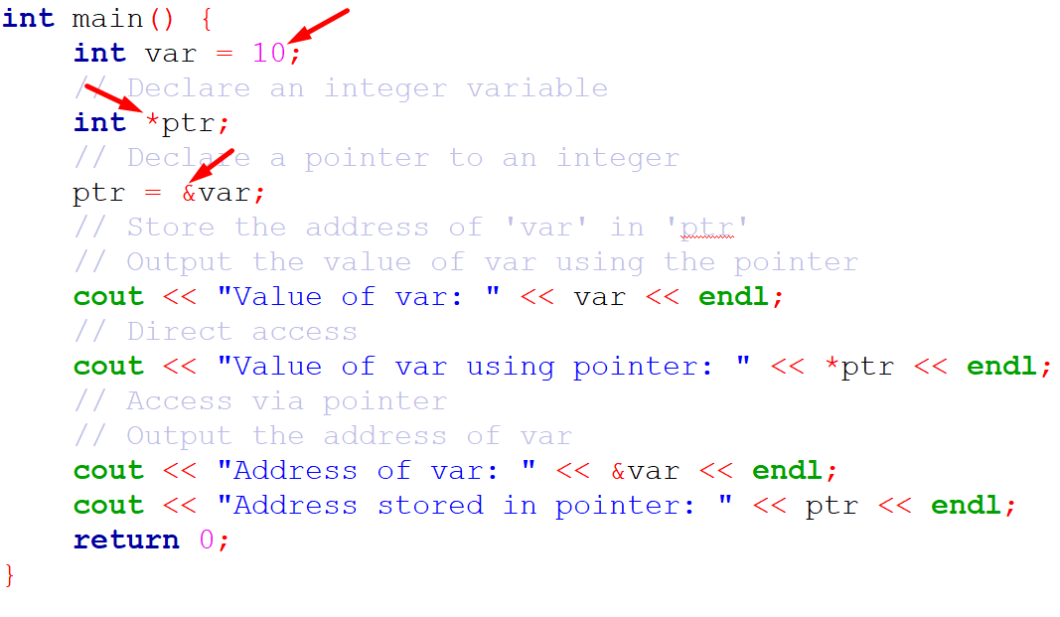
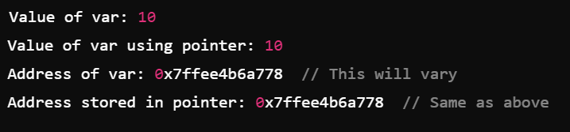
pointer
Output:

Slide 79
pointer
Explanation:
int var = 10; declares an integer variable var and assigns it the value 10.
int *ptr; declares a pointer ptr that can store the address of an integer.
ptr = &var; assigns the address of var to the pointer ptr.
*ptr dereferences the pointer to access the value of var through the pointer.
It accesses the value stored at the memory address that the pointer points to.

Slide 80
pointer
Explanation:
int var = 10; declares an integer variable var and assigns it the value 10.
int *ptr; declares a pointer ptr that can store the address of an integer.
ptr = &var; assigns the address of var to the pointer ptr.
*ptr dereferences the pointer to access the value of var through the pointer.
It accesses the value stored at the memory address that the pointer points to.

Slide 81
references

Slide 82
references
In C++, references provide an alias (another name) for an existing variable. A reference allows you to work with the original variable directly without creating a copy, making it useful for passing arguments to functions or returning values from functions without unnecessary copying.
Key Points About References in C++:
Declared using the & symbol.
Must be initialized when created (you cannot have an uninitialized reference).
A reference is not a separate object, but another name for the original variable.
Changes made to the reference affect the original variable.

Slide 83
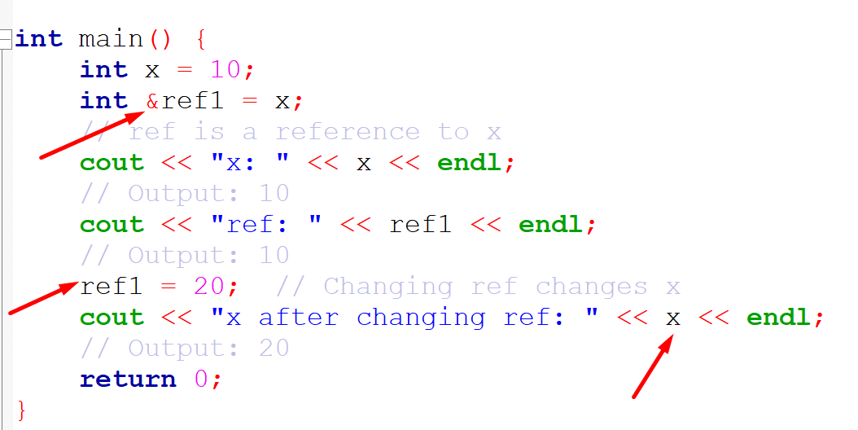
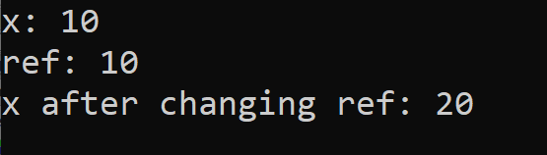
references
Explanation:
int &ref = x; creates a reference ref to the variable x. Both ref and x refer to the same memory location.
Changing the value of ref (ref = 20;) changes the value of x since ref is just an alias for x.
Output:

Slide 84
Some Keywords week-5

Slide 85
const

Slide 86
const
In C++, the const keyword is used to make a variable, pointer, or object constant, meaning its value cannot be modified after initialization.
There are several ways to use const in C++, including with
  Variables
  pointers,
  function argument
Here are some common example: const with Pointers

Slide 87
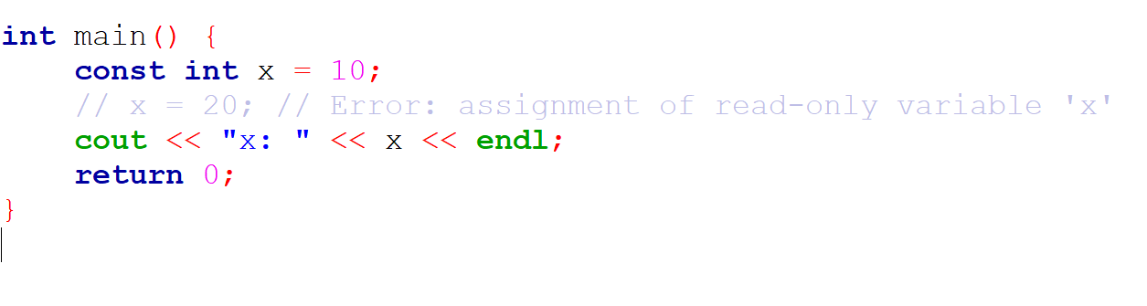
const with Variables
A const variable cannot be modified after it is initialized.
In this example, x is a constant, so trying to modify x will result in a compilation error.

Slide 88
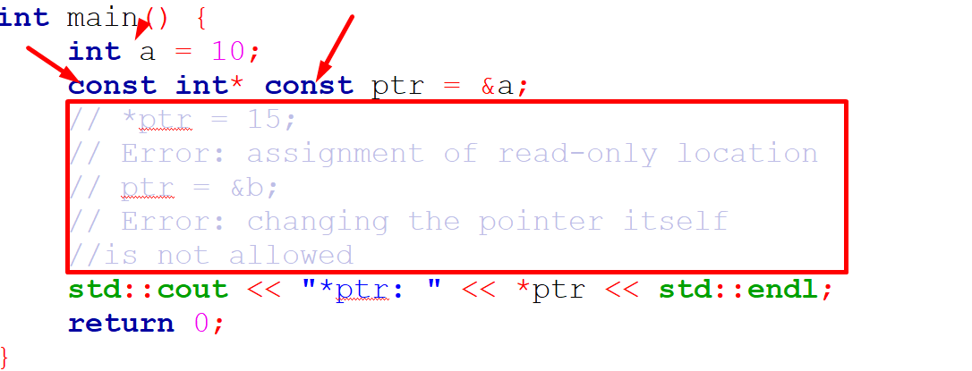
const with Pointers
There are different ways to use const with pointers depending on what you want to make constant
Constant pointer to a constant value: Neither the pointer nor the value it points to can be modified.

Slide 89
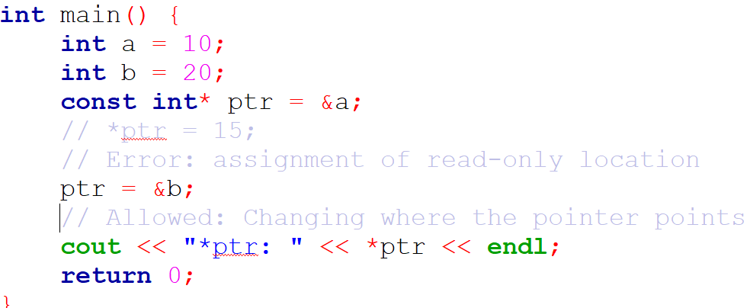
const with Pointers
Pointer to a constant value: The value pointed to by the pointer is constant (cannot be changed)
But the pointer itself can be modified to point elsewhere.

Slide 90
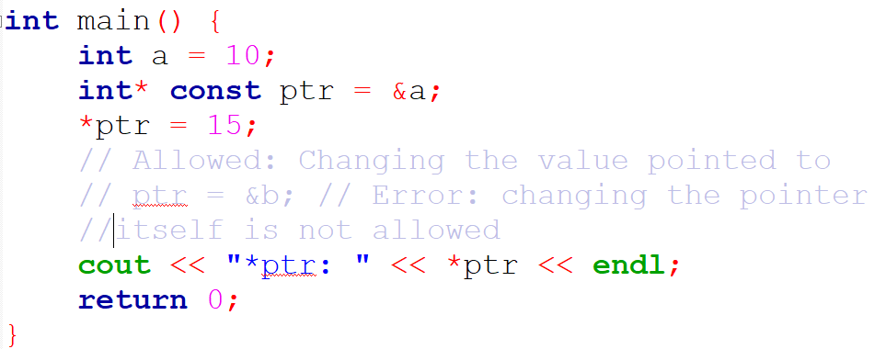
const with Pointers
Constant pointer to a non-constant value: The pointer itself cannot be changed, but the value it points to can be modified.

Slide 91
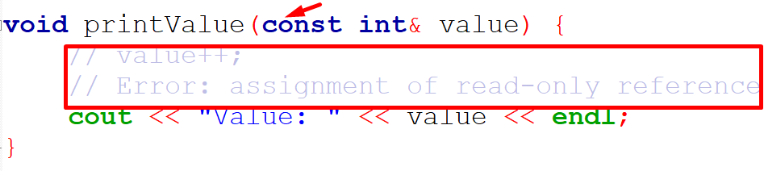
const in Function Arguments
You can pass arguments to a function as const to ensure that they cannot be modified inside the function.
In this case, value is passed by reference, but it is const, meaning the function is not allowed to modify value.

Slide 92
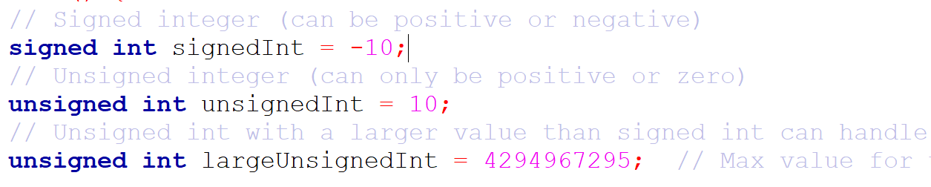
signed and unsigned
In C++, both signed and unsigned are used to modify the range of numeric data types like int and char.
The default for most numeric types (e.g., int) is signed.
signed: Can store both positive and negative values.
unsigned: Can only store non-negative values but provides a larger range for positive numbers.

Slide 93
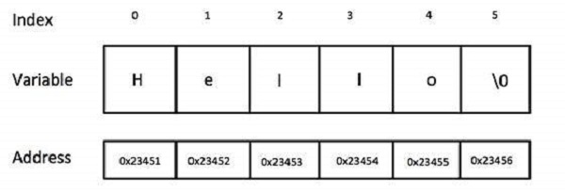
string
string (from the STL) std::string is a part of the C++ Standard Library, used to handle text (sequences of characters).
It provides a more flexible and powerful way to work with strings than using raw character arrays.

Slide 94
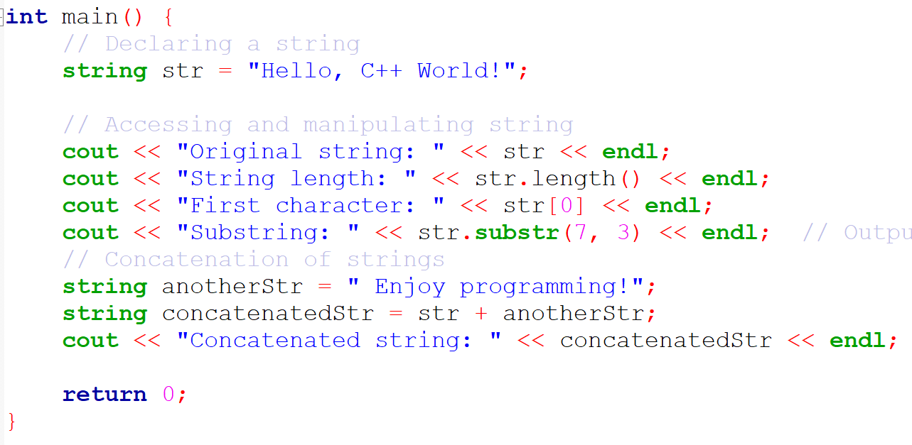
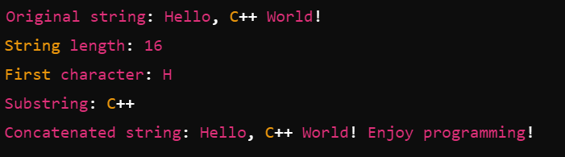
string
Output:

Slide 95
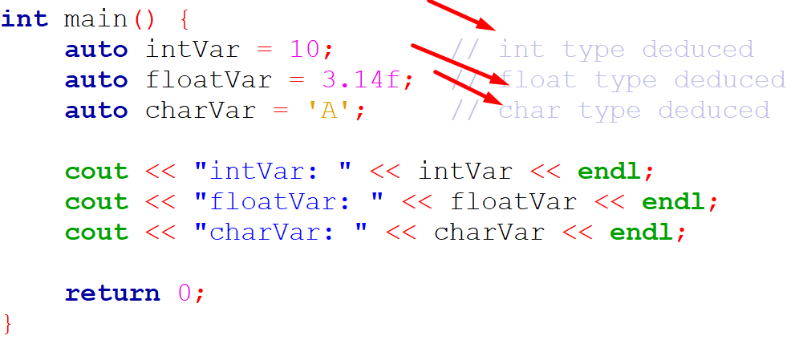
auto
In C++, the auto keyword is used for type inference, allowing the compiler to automatically deduce the type of a variable from its initializer.
This makes code easier to read and write, especially with complex types or when using templates.

Slide 96
static
In C++, the static keyword has different meanings depending on the context in which it is used.
It can be applied to variables (both global and local), member variables of a class, and member functions of a class.
Let's break down the use of static in each context:
  Static Global Variables
  Static Local Variables

Slide 97
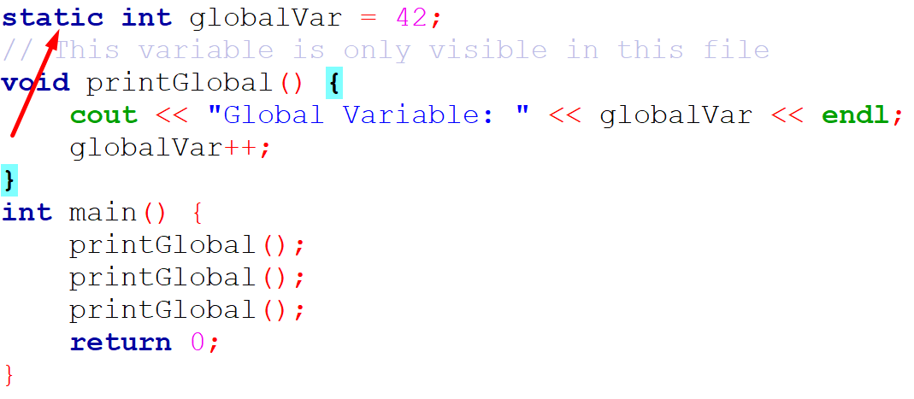
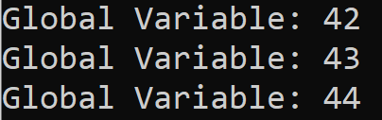
Static Global Variables
A static global variable limits the visibility of the variable to the file in which it is declared.
This makes it internal linkage, meaning it is not accessible from other files in the program.
globalVar is accessible only within the file where it is defined.
Output:

Slide 98
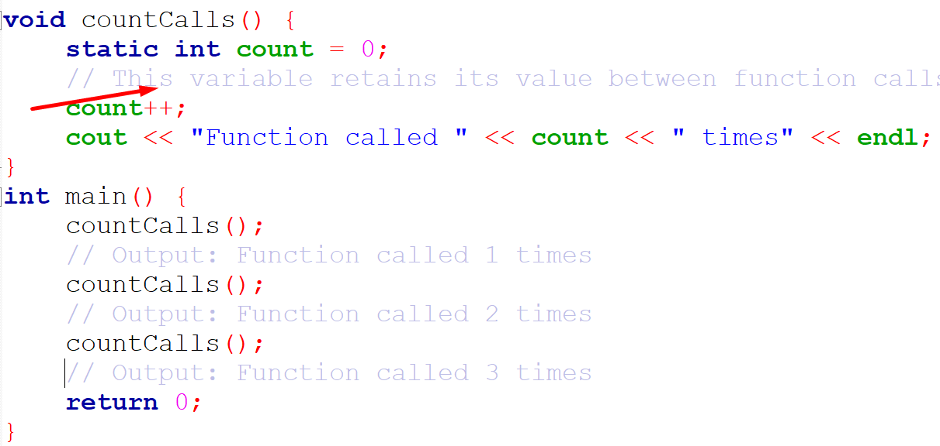
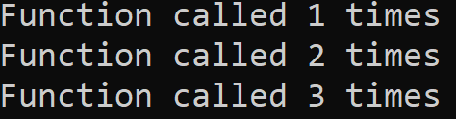
Static Local Variables
A static local variable inside a function retains its value between function calls.
Normally, a local variable is destroyed once the function ends, but a static local variable keeps its value across multiple calls to the function.
Output:
Output:

Slide 99
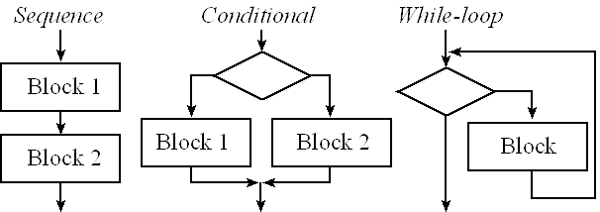
Control Structures week-6

Slide 100
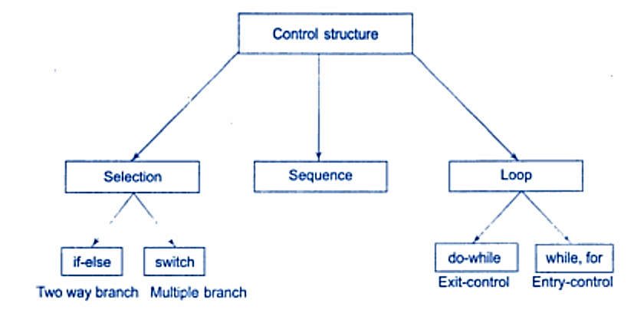
Control Structures

Slide 101
Conditional

Slide 102
if-else
if-else Statement
The if-else statement is used when you want to test a condition and execute code based on whether that condition is true or false.
It can handle complex conditions, and multiple else if branches can be used.
if (condition) {
// Code block if condition is true
} else if (another_condition) {
// Code block if another_condition is true
} else {
// Code block if all conditions are false
}

Slide 103

if-else
Explanation:
The program checks whether the entered number is positive, negative, or zero and prints the corresponding message.
if checks the first condition (number > 0), and if it’s true, the associated block is executed.
else if is used to check additional conditions (number < 0).
else provides a default action if none of the previous conditions are true.

Slide 104

switch
The switch statement is used when you need to select one out of many options based on the value of a single variable (typically an integer or a character).
It’s more efficient than a series of if-else statements when testing the same variable for equality against different values.

Slide 105
if-else vs switch
Aspect | if-else | switch
Conditions | Can evaluate complex conditions. | Only evaluates equality of a single value.
Data Types | Works with all data types (int, float, string, etc.). | Works with int, char, or enum types.
Efficiency | Less efficient with many conditions. | More efficient for checking multiple values of the same variable.
Range Checking | Can handle ranges (x > 10, x < 5, etc.). | Cannot check ranges directly (only equality).
Fall-through | Does not allow fall-through between conditions. | Allows fall-through between cases unless break is used.
Usage | Used for complex conditions or when multiple different variables are involved. | Used when comparing a single variable against multiple constant values.

Slide 106
try, catch, and throw
In C++, try, catch, and throw are used to handle exceptions (runtime errors) in a safe and controlled way.
This mechanism is known as exception handling.
throw: Used to signal (raise) an exception.
try: Block of code where exceptions might occur.
catch: Block of code that handles the exception.

Slide 107


try, catch, and throw
Output:

Slide 108
Loops

Slide 109

Loops
In C++, for, while, and do-while are control flow statements used to create loops.
They allow you to execute a block of code multiple times based on certain conditions.

Slide 110



for Loop
The for loop is typically used when the number of iterations is known beforehand.
It consists of three parts: initialization, condition, and increment/decrement.

Slide 111


while Loop
The while loop is used when the number of iterations is not known beforehand and depends on a condition.
loop continues as long as the condition is true.

Slide 112


do-while Loop
The do-while loop is similar to the while loop, but it guarantees that the code block will execute at least once, since the condition is checked after the code block is executed.

Slide 113
Key Differences Between Loops
Aspect | for Loop | while Loop | do-while Loop
Usage | When the number of iterations is known. | When the number of iterations is not known. | When at least one iteration is required.
Condition Check | At the beginning of each iteration. | At the beginning of each iteration. | At the end of each iteration.
Execution Guarantee | May not execute if the condition is false. | May not execute if the condition is false. | Will execute at least once, regardless of condition.

Slide 114
When to Use Each Loop
for Loop: Best used when you know the exact number of iterations beforehand (e.g., iterating through arrays).
while Loop: Suitable for situations where you want to repeat a block of code an indefinite number of times based on a condition.
do-while Loop: Ideal when you want to ensure the code block runs at least once before checking the condition.

Slide 115
Function week-7

Slide 116
Function
In C++, functions are used to encapsulate a block of code that performs a specific task. The use of functions offers several advantages:
Code Reusability: Once you define a function, you can reuse it throughout the program by calling it multiple times without rewriting the same code.
Modularity: Functions allow you to break down large, complex problems into smaller, manageable pieces (modules), making the program easier to understand and maintain.
Improved Readability: Functions help structure the program more logically, making the code more readable. It is easier to understand what each part of the code does by looking at its function name.

Slide 117
Function Cont.
Easier Debugging: Errors can be isolated more easily in functions. If something goes wrong, you can debug a specific function rather than the whole program.
Avoid Redundancy: Functions reduce redundancy, meaning that you can write a piece of code once and use it many times, leading to cleaner and more efficient code.
Abstraction Functions: abstract away the details of their implementation, allowing the user to focus on what the function does rather than how it does it.

Slide 118

Main Function
In C++, the main function is the entry point of any C++ program. It is the first function that gets executed when the program starts and the place where the program ends.
Key Points about the main Function:
Only One main: Every C++ program must have exactly one main function. Without it, the program will not compile or run.
Return Type: The return type of main is int, meaning it should return an integer value. Typically, a return value of 0 indicates successful program execution, while a non-zero value indicates an error.

Slide 119
Main Function Cont.
Arguments: main can accept arguments, which are typically used for handling command-line input. These arguments are argc (argument count) and argv (argument vector).
Execution: The execution of the program begins from main. The code inside the main function is what gets executed, and once the function completes, the program terminates.

Slide 120
function prototype
A function prototype in C++ is a declaration of a function that informs the compiler about the function's name, return type, and parameters without providing the full definition of the function.
It is typically placed at the beginning of a program or in a header file.
The purpose of a function prototype is to allow functions to be called before they are defined.
In C++, the function body is where the actual code or logic of the function is written.
It consists of a block of statements that define what the function does.
The function body is placed inside curly braces {} after the function's declaration.

Slide 121

function prototype
Structure of a Function Definition:
Return Type: The type of value the function will return (e.g., int, void).
Function Name: The name used to call the function.
Parameters: Variables that receive values from the calling function.
Function Body: The block of code inside {} that performs the operation.

Slide 122

Call by Value
In call by value, the actual value of the argument is passed to the function.
A copy of the argument is made, and changes made to the parameter inside the function do not affect the original variable.

Slide 123

Call by Reference
In call by reference, the actual memory address of the argument is passed to the function, allowing the function to modify the original variable directly.
Changes made inside the function are reflected in the original variable.

Slide 124

Call by Pointer
In call by pointer, the memory address (pointer) of the variable is passed to the function.
The function can use this pointer to access and modify the original variable.
Like call by reference, changes made inside the function will affect the original variable, but the syntax involves pointers.

Slide 125

Return by Reference
When a function returns by reference, it returns a reference (alias) to the original variable. This allows the caller to access and modify the original value directly.
The returned reference should point to a valid object or variable.
Returning by reference can be more efficient than returning by value, especially for large objects, as it avoids copying.
Be cautious not to return a reference to a local variable, as it goes out of scope when the function ends, leading to undefined behavior.

Slide 126

Return by Pointer
When a function returns a pointer, it returns the memory address of a variable. The caller can then use this pointer to access or modify the value at that memory address.
The function must ensure the returned pointer points to a valid memory location
Returning pointers is useful when dealing with dynamic memory allocation or when you want to return a null pointer to indicate failure.
Like returning by reference, care must be taken not to return a pointer to a local variable (stack memory), as this would lead to undefined behavior.

Slide 127
Differences
Method | What is Passed | Can Modify Original Variable? | Syntax in Function Definition
Call by Value | A copy of the argument | No | void func(int x)
Call by Reference | A reference to the argument | Yes | void func(int &x)
Call by Pointer | A pointer to the argument | Yes | void func(int *x)

Slide 128
inline function

Slide 129

inline function
In C++, an inline function is a function where the compiler attempts to expand the function's code at the point of each function call rather than performing a normal function call.
This can result in faster execution because it avoids the overhead associated with a typical function call, such as pushing parameters to the stack, jumping to the function's memory location, and returning control back to the caller.

Slide 130
Inline Functions cont.
How Inline Functions Work
When you declare a function as inline, you are making a request to the compiler to expand the code in place where the function is called, rather than executing the function through the normal call mechanism.
However, it is important to note that inline is just a request, and the compiler may choose to ignore the request if it deems the function too complex or unsuitable for inlining.
Advantages of Inline Functions
Performance Boost: For small functions, eliminating the overhead of function calls can make the program run faster.
Code Readability: Even though the function call is replaced with the actual code, it still maintains the readability and structure of the function.

Slide 131
Inline Functions cont.
Limitations of Inline Functions:
Large Functions: If the function is large, inlining it can actually increase the binary size of the program, which may negatively impact performance (this is known as code bloat).
Recursive Functions: Inline functions cannot be recursive, or inlining would result in infinite expansion.
Compiler’s Decision: The compiler may choose not to inline a function even if it is declared as inline, especially if the function contains loops, recursion, or other complex structures.

Slide 132
Default Arguments And Function Overloading week-8

Slide 133
default arguments
In C++, default arguments allow you to provide default values for function parameters, which are used when the caller of the function does not supply values for those parameters.
Default arguments are specified in the function declaration or prototype, and they allow for more flexibility in function calls by making some parameters optional.

Slide 134


default arguments

Slide 135

Function overloading
Function overloading in C++ is a feature that allows multiple functions with the same name to exist in the same scope, provided they differ in the type or number of their parameters.
Key Points:
Same Function Name: Multiple functions share the same name.
Different Parameter List: Functions must differ in the number, type, or order of parameters.
Return Type Doesn't Matter: Function overloading is not based on return type. The compiler resolves which function to call based on the parameter list only.

Slide 136

Function overloading cont.

Slide 137
Ambiguity Problem with Default Arguments and Function Overloading
When using function overloading and default arguments together in C++, there are potential issues that can lead to ambiguity, making it difficult for the compiler to determine which function to call.
The key issue arises when default arguments in one overloaded function conflict with the parameter lists of other overloaded functions.
The main problem occurs when the combination of default arguments and function overloading creates ambiguous situations where the compiler cannot decide which function to call.

Slide 138

Ambiguity Problem with Default Arguments and Function Overloading

Slide 139


Recursive Functions in C++
Recursion is a programming technique where a function calls itself to solve smaller instances of the same problem.
It is particularly useful for problems that can be broken down into similar sub-problems, like tree traversal, factorial calculation, and dynamic programming problems such as Fibonacci sequence generation.

Slide 140
Class and Object week-9

Slide 141

Class in C++
In C++, a class is a blueprint for creating objects. It encapsulates data members (variables) and member functions (methods) into a single unit, following the principles of object-oriented programming (OOP), such as encapsulation, abstraction, inheritance, and polymorphism.
Class: Defines a new data type that groups data members (attributes) and member functions (methods).
Object: An instance of a class. A class is like a blueprint, and an object is a concrete instance of that blueprint.
Access Specifiers: public, private, and protected control the visibility of members.

Slide 142

class declaration
In C++, a class declaration inside a header file typically defines the blueprint for an object, and the function definitions can be placed outside the class declaration.
Here's the syntax for declaring a class and defining its member functions inside the class.

Slide 143

Member Functions Inside the Class
In C++, member functions can be defined inside the class, and when defined this way, they are implicitly treated as inline functions.
A member function is a function that operates on an instance (object) of a class and has access to the data members of the class.

Slide 144


Member Functions Outside
The Class
In C++, you can declare member functions outside the class definition by providing their declarations within the class and defining them outside the class using the scope resolution operator (::)

Slide 145

class object
In C++, a class object is an instance of a class. When you create an object, memory is allocated for it, and you can access its members (variables and functions) based on the access specifiers (public, private, protected) defined in the class.

Slide 146

Data Hiding And Encapsulation week-10

Slide 147
Encapsulation
Encapsulation is a broader concept that involves bundling the data (attributes) and the methods (functions) that operate on that data into a single unit, called a class.
It is the mechanism of restricting access to some of the object's components and only exposing necessary functionalities.
To achieve data abstraction by providing a public interface to interact with the object's data, while keeping the actual data and internal workings hidden.
By using private, protected, and public access specifiers to control the visibility and accessibility of data and functions inside a class.
The class acts as a protective capsule that hides its data, while allowing controlled access via public methods.

Slide 148

data hiding
In C++, data hiding is a key concept in object-oriented programming, achieved by controlling access to the members (data and functions) of a class.
This is done using access specifiers like private, protected, and public.

Slide 149
data hiding cont.
Private members are accessible only within the class itself, and not from outside.
This ensures that the internal implementation details of the class are hidden from the user, protecting the integrity of the data.

Slide 150

Data Hiding Vs. Encapsulation
Data Hiding:
The member variable value is declared as private, so it cannot be accessed directly from outside the class.
This is an example of data hiding.
The user of the class cannot directly modify or view value but has to go through public methods, ensuring the data's integrity.

Slide 151
Data Hiding Vs. Encapsulation
Encapsulation:
The methods getValue() and setValue(int value) are public methods that provide controlled access to the private member variable.
These methods encapsulate the internal workings and expose only the necessary interface.
setValue() checks if the value is valid before modifying the value , which is an example of controlled access and data protection.

Slide 152
this Pointer

Slide 153
this Pointer
The this pointer is a special pointer available to all non-static member functions of a class.
It is implicitly passed to the member functions and points to the current object (the object that invoked the function).
This pointer is an essential part of how C++ works with objects and provides a way for member functions to access the calling object.

Slide 154


this Pointer
The this pointer is a special pointer available to all non-static member functions of a class. It is implicitly passed to the member functions and points to the current object (the object that invoked the function).
This pointer is an essential part of how C++ works with objects and provides a way for member functions to access the calling object.

Slide 155
Nesting Member Functions

Slide 156

Nesting Member Functions
In C++, nesting member functions refers to a situation where one member function of a class calls another member function from the same class.
This is a common practice to keep code organized and to allow for modular function behavior.

Slide 157

nesting member functions cont.
showResult(): This public function calls the private add() function to calculate the sum of two numbers.
add(): This is a private member function that performs the addition of two numbers.

Slide 158
Memory Allocation For Class Objects week-11

Slide 159

Memory Is Allocated For Class Objects
Common for All Objects (Shared Memory for Member Functions):Member functions are shared among all objects of the class.
Memory for member functions is allocated once when the class is defined, not when each object is created.
This is because member functions do not hold data;
they act on the data (variables) that each object possesses individually.
.

Slide 160
Memory Is Allocated For Class Objects
Memory Created for Each Object (Instance Variables):
Member variables (data members) are unique for each object.
Every time an object is created, memory is allocated for its member variables.
In the image, Object 1, Object 2, and Object 3 each have their own separate memory for member variable 1 and member variable 2.
The member variables hold the data for each object, and memory for these variables is created when the objects are defined.

Slide 161


Memory Is Allocated For Class Objects
The addresses of fun_var for both objects will likely be the same (or very close), as member_fun() is executed in the same context of stack memory.
The addresses of number will be different for obj1 and obj2, as they refer to separate instances of MyClass.

Slide 162
Static Data Member

Slide 163
Static Data Member
In C++, a static member is a class member that is shared by all instances of the class.
Static members can be variables or functions, and they are associated with the class itself rather than any specific object.
This means that static members are shared across all objects of the class, and they can be accessed without creating an instance of the class.
A static member variable is allocated only once, regardless of how many objects are created from the class.
All objects share the same copy of that variable.
This means every object has access to the same memory location for the static member, and changes made to that variable through one object will be reflected in all other objects.

Slide 164

static data member cont.
The static member variable number2 is declared inside the class using the static keyword.
Static member variables are shared among all objects of the class.
There is only one copy of the static variable, regardless of how many objects are created.
Static member variables must be defined outside the class.
This is necessary because they exist at the class level, not the instance level.
Inside the member function member_fun(), both the regular and static member variables are accessed

Slide 165


static data member cont.
number1 is unique for each object, so its address will differ for each object (obj1, obj2).
number2 is static, meaning its address will be the same for all objects (obj1, obj2) because only one copy of number2 exists.

Slide 166
Friend Function

Slide 167

Friend Function
In C++, a friend function is a function that is not a member of a class but is given access to the class's private and protected members.
Normally, only member functions of a class can access its private and protected members.
However, by declaring a function as a friend, the class gives that function access to its internal data.

Slide 168
Characteristics of Friend Functions
A friend function is not a member of the class, yet it can access the private and protected members of the class.
A friend function has access to the private and protected members of a class, which otherwise would not be accessible from outside the class.
A friend function is declared inside the class, but its definition is written outside the class.
It is prefixed with the friend keyword in the class declaration.

Slide 169
Characteristics of Friend Functions
A friend function can be a global function or a member function of another class.
Friendship is not inherited, which means derived classes do not inherit the friend functions of their base classes.
A single friend function can be declared as a friend by multiple classes, allowing it to access the private members of more than one class.
Since a friend function is not a member of the class, it does not have a this pointer (unlike member functions of the class).

Slide 170

Friend Functions Example
MyClass is a class with a private member variable number1 and a private member function display_member_fun().
These cannot be accessed directly from outside the class.
The function display_friend(MyClass oj) is declared as a friend function of the class MyClass.
Being a friend function allows it to access private members (variables and functions) of the class directly, which would otherwise be inaccessible.

Slide 171
Friend Functions Example cont.
Since display_friend is a friend of MyClass, it can directly access the private member number1.
Here, the function assigns 100 to number1.
Even though display_member_fun() is private, the friend function can call it. This function prints the message "member function".

Slide 172


Friend Functions Example cont.
An object oj of class MyClass is created.
The private members (number1 and display_member_fun()) cannot be accessed directly through oj in the main() function.
The friend function display_friend() is called directly with the object oj as an argument.
The friend function can access the private member variable and member function of oj, despite them being private.
Friend functions are not called using an object of the class, as they are not class members.
Instead, they are called like normal non-member functions.

Slide 173
MID EXAM

Slide 174
Constructors week-12

Slide 175

Constructors in C++
In programming, constructors are special methods used to initialize objects in classes.
They allow for setting up initial conditions for the object when it's created, such as assigning default values to its properties.
Constructors are a core feature in object-oriented programming (OOP) and are often recognized by their unique characteristics in different languages.

Slide 176
Characteristics of Constructors
1.Automatic Invocation on Object Creation
  A constructor is automatically called when a new instance of a class is created, so it’s never explicitly called like regular methods.
  Developers don’t need to call the constructor directly; it’s implicitly invoked during object creation.
2. Same Name as the Class
  In most languages (e.g., Java, C++, and PHP), a constructor must have the same name as the class, which differentiates it from other methods.
3. No Return Type
  No Return Type Specified: Constructors don’t have a return type, not even void, as their purpose is solely to initialize objects rather than return values.
  Constructors initialize the object's state without returning any output.

Slide 177
Characteristics of Constructors Cont.
4. Multiple Constructors (Overloading)
  Constructor Overloading: Many languages support constructor overloading, allowing multiple constructors with different parameter lists to coexist within a single class.
5. Cannot Be Called Directly
  Implicit Call Only: You cannot invoke a constructor as you would with regular methods. It's only called indirectly through object instantiation.
6. Inheritance and Constructors
  Inherited Behavior: In languages like Java and C++, if a class inherits another class, the constructor of the superclass is automatically called before the subclass constructor.
  Chained Constructors: Constructors can call each other in a chain (e.g., a parameterized constructor calling a default constructor), typically via the this or super keywords.

Slide 178

Types of Constructors
Default Constructor: A constructor with no parameters. It initializes objects with default values.
Parameterized Constructor: Accepts parameters to assign specific values to object properties at creation.
Copy Constructor: Creates a new object as a copy of an existing object (common in C++).

Slide 179
Default Constructor

Slide 180
Default Constructor
In C++, a default constructor is a type of constructor that takes no parameters.
Its primary purpose is to initialize an object with default values.
If no constructor is explicitly defined for a class, the compiler automatically provides a default constructor,
which initializes the object with default values for its members (if applicable).

Slide 181

Characteristics of a Default Constructor
No Parameters: The default constructor has no parameters, so it doesn't take any arguments.
Implicit Creation: If no other constructors are defined, the compiler generates a default constructor automatically.
Automatic Initialization: It initializes the object with default values, which can be user-defined if explicitly written.

Slide 182
Parameterized Constructor

Slide 183

Parameterized Constructor
In C++, a parameterized constructor is a constructor that takes one or more parameters, allowing you to initialize an object with specific values at the time of creation.
This type of constructor provides flexibility in object initialization, letting you set object properties with custom values instead of default ones.

Slide 184
Characteristics of a Parameterized Constructor
Takes Parameters: Unlike the default constructor, a parameterized constructor requires arguments, enabling the assignment of specific values to data members.
Overloading Possibility: Parameterized constructors can be overloaded, meaning you can have multiple constructors with different parameter lists within the same class.
No Return Type: As with all constructors, parameterized constructors have no return type.

Slide 185
Characteristics of a Parameterized Constructor Cont.
Automatic Invocation with Arguments: When an object is created with arguments, the parameterized constructor is automatically called.
Improves Code Flexibility: Enables the creation of objects in different states without needing setter methods after instantiation.

Slide 186
Overloading Parameterized Constructor
In C++, constructor overloading allows a class to have multiple constructors with different parameter lists.
This enables objects to be initialized in different ways based on the arguments passed.
Overloaded constructors are a form of function overloading where each constructor has the same name as the class but a unique set of parameters.

Slide 187
Characteristics of Overloaded Constructors
Same Name, Different Parameters: Each overloaded constructor shares the same name as the class but has different numbers or types of parameters.
Flexible Initialization: Allows objects to be created with varying levels of detail, providing default or customized values depending on the use case.
Code Reusability: Avoids the need to create multiple classes for similar initialization logic, as one class can handle various initialization needs.
Automatic Selection: The compiler determines which constructor to use based on the arguments provided during object creation.

Slide 188


Overloading Parameterized Constructor Example

Slide 189
Copy Constructor week-13

Slide 190
Copy Constructor
In C++, a copy constructor is a special constructor used to create a new object as a copy of an existing object.
It takes a reference to an object of the same class as an argument, copying the values of each data member from the original object to the new one.
Copy constructors are essential when you want to duplicate objects, especially when they contain dynamically allocated resources, ensuring a deep copy rather than a shallow

Slide 191
Copy Constructor Cont.
Copies Another Object: The copy constructor creates a new object that’s an exact copy of an existing object of the same class.
One Argument: It takes one argument, which is a reference to the object you want to copy.
Automatic Call: The copy constructor is automatically called in certain situations, like:
  When you create a new object from an existing one, e.g., MyClass obj2 = obj1;
  When an object is passed by value to a function or returned by value.

Slide 192

Copy Constructor Cont.
Default by Compiler: If you don’t define your own copy constructor, C++ will create a simple one for you.
However, this default one might only do a "shallow copy" (copying values as they are), which can lead to issues if the class contains pointers or other dynamic data.

Slide 193


Copy Constructor Cont.
Output:

Slide 194
Destructor

Slide 195
Destructor in C++
In C++, a destructor is a special member function of a class that is automatically called when an object goes out of scope or is explicitly deleted.
The destructor’s main role is to release resources the object may have acquired during its lifetime, such as dynamically allocated memory or file handles.
A destructor has the same name as the class, but it starts with a ~ symbol.
Destructors don’t take any arguments and cannot be overloaded, meaning each class can have only one destructor.

Slide 196
Destructor in C++
A destructor is automatically called when:
  An object goes out of scope (e.g., at the end of a function or block).
  An object is deleted explicitly using the delete keyword.
Destructors don’t return a value, not even void.
Destructors are essential for freeing memory and other resources like file handles or network connections to prevent resource leaks.

Slide 197


Destructor in C++ Example

Slide 198
Inheritance week-14

Slide 199
Inheritance
Inheritance is a key feature of object-oriented programming (OOP) in C++, allowing a class (called a derived or child class) to inherit properties and behaviors (data members and member functions) from another class (called a base or parent class).
This promotes code reuse, extensibility, and polymorphism.
Types of Inheritance in C++Single Inheritance: A derived class inherits from one base class.
Multiple Inheritance: A derived class inherits from more than one base class.
Multilevel Inheritance: A class inherits from a derived class, forming a chain.Hierarchical Inheritance: Multiple classes inherit from a single base class.Hybrid Inheritance: A combination of the above types, often involving multiple and multilevel inheritance.

Slide 200

Inheritance
Inheritance is a key feature of object-oriented programming (OOP) in C++, allowing a class (called a derived or child class) to inherit properties and behaviors (data members and member functions) from another class (called a base or parent class).

Slide 201
Types of Inheritance

Slide 202

Types of Inheritance

Slide 203
Single Inheritance
The Inheritance in which a single sub class is inherited from a single base class Is known as the single inheritance.

Slide 204

Single Inheritance Example

Slide 205

  Multiple Inheritance
In Multiple Inheritance ,a class can inherit more than one class.
In this types of inheritance a single child class can have multiple parent classes.

Slide 206

  Multiple Inheritance

Slide 207

  Hierarchical Inheritance
In this sort of inheritance, multiple subclass derived form single superclass.

Slide 208

  Hierarchical Inheritance

Slide 209

  Multilevel Inheritance

Slide 210
  Hybrid Inheritance

Slide 211


Inheritance and Access Modifiers

Slide 212

  Inheritance and Access Modifiers

Slide 213
Method Overriding week-15

Slide 214

Method Overriding

Slide 215

  Ambiguity Resolution

Slide 216
Create Objects in Heap
Creating objects in the heap refers to the dynamic allocation of memory for objects at runtime.
In programming, especially in languages like C++ and Java, memory can be managed in two main regions: stack and heap.
Heap Memory:
Heap is a memory area in RAM used for dynamic memory allocation.
Objects created in the heap remain in memory until they are explicitly deleted (or garbage-collected in languages like Java).
Heap memory allows for more flexible and persistent storage, suitable for objects that need to outlive the function in which they were created or require a variable amount of memory.

Slide 217

Create Objects in Heap
A class sum is defined with a public member function display().The display() function outputs "In Heap" to the console.
In the main() function, a pointer oj of type sum is declared.
The new operator is used to allocate memory for the sum object in the heap and initialize it.
The expression new sum() creates an instance of the class sum and returns a pointer to this object.
The oj pointer now points to this dynamically allocated object in heap memory.
The -> operator is used to call the display() method on the heap-allocated object through the pointer oj.
This outputs "In Heap" to the console.

Slide 218
Benefits And Drawbacks of Heap Allocation
Benefits of Heap Allocation
Persistence Across Scopes: Objects in the heap are not limited by the scope of a function, so they can be accessed and modified as long as they’re not deleted.
Flexibility: The amount of memory allocated can vary at runtime, making it ideal for handling data where size isn’t fixed at compile time.
Control Over Lifespan: You control when to allocate and deallocate memory, allowing efficient use of resources.
Drawbacks of Heap Allocation:
Manual Memory Management: In languages like C++, you must remember to delete objects, or you risk memory leaks.
Slower Access: Accessing heap memory can be slower than stack memory because of the need to manage pointers.

Slide 219
Create Objects in Stack
Creating objects on the stack refers to allocating memory for an object within the scope of a function, usually automatically managed by the system.
The memory for stack objects is allocated when the object is created and deallocated when the object goes out of scope.
Stack memory is typically used for local variables.
In C++, objects can be created on the stack simply by declaring them as local variables.
Stack objects are automatically destroyed when they go out of scope, so there's no need to manually delete them.
The pointer to a stack object, however, can be used to access its members and methods, but the object itself is still in stack memory.

Slide 220

Create Objects in Stack
The object oj is declared as a local variable inside the main() function.
It is automatically created on the stack when the function starts and automatically destroyed when the function ends.
The class sum has a member function display(), which prints "In Stack" to the console.
sum *pt; declares a pointer pt that will point to an object of type sum.pt = &oj; assigns the address of the oj object (which is located on the stack) to the pointer pt.
pt->display(); calls the display() function of the oj object through the pointer pt. The pointer pt holds the address of the stack-allocated oj object, so calling pt->display() will invoke the display() method of the oj object.

Slide 221
Benefits And Drawbacks of Objects in Stack
Benefits
Faster Memory Management: Stack memory is managed automatically and very quickly, as it simply involves incrementing or decrementing the stack pointer.
Automatic Deallocation: Objects created on the stack are automatically deallocated when they go out of scope (when the function ends), reducing the risk of memory leaks.
Simplicity: No need to explicitly delete objects, unlike heap-allocated objects.
Drawbacks :
Limited Size: Stack space is limited compared to heap memory. If too much memory is allocated on the stack (e.g., for large objects), it may cause a stack overflow.
Short Lifetime: Stack objects exist only within the scope of the function in which they are created. Once the function returns, the object is destroyed.

Slide 222

Virtual Function

Slide 223
Abstraction And Interfaces week-16

Slide 224

Pure Virtual Function
A pure virtual function in C++ is a function declared in a base class that must be overridden in any derived class.
It is declared by assigning 0 to the function declaration

Slide 225
Interfaces
An interface is a concept used in OOP to define a contract or blueprint that derived classes must adhere to.
In C++, an interface is implemented using an abstract class that contains only pure virtual functions.
Characteristics of an Interface:
Contains only pure virtual functions.
Cannot have data members or function implementations (except in rare cases with modern C++ for default implementations).

Slide 226



Pure Virtual Function & Interfaces
Output:

Slide 227
Abstraction in C++
Abstraction is one of the key principles of object-oriented programming (OOP).
It refers to the concept of hiding the implementation details of a class and exposing only the essential features.
By using abstraction, we focus on what an object does rather than how it does it.
In C++, abstraction is typically achieved using:
  Abstract classes (classes with at least one pure virtual function)
  Interfaces (abstract classes containing only pure virtual functions)

Slide 228

Abstraction in C++
Explanation Abstract Class: The Vehicle class has a pure virtual function start(). It cannot be instantiated directly.
Derived Classes: Car and Bike override the start() function to provide specific implementations.
Polymorphism: Using pointers to the Vehicle class, the start() function calls the appropriate implementation based on the derived class type.

Slide 229


Abstraction in C++ Cont.
Output:

Slide 230
Generalization and Specialization week-16

Slide 231

Generalization and Specialization
In object-oriented design, Generalization and Specialization describe how classes relate hierarchically, specifically in terms of inheritance.

Slide 232
Generalization and Specialization
Generalization:
It is the process of extracting shared characteristics (attributes or methods) from two or more classes and creating a common parent class.
Purpose: To reduce redundancy and create reusable code.
Example: Car and Truck are generalized into a parent class Vehicle.

Slide 233
Generalization and Specialization
Specialization
It is the process of creating more specific classes from a general parent class by adding unique characteristics or behaviors.
To extend functionality and tailor behavior to specific requirements.
From the generalized class Vehicle, we create specialized classes Car and Truck.

Slide 234
Generalization and Specialization
Aspect | Generalization | Specialization
Definition | Combining common features into a base class. | Adding unique features to derived classes.
Direction | Bottom-up (from specific to general). | Top-down (from general to specific).
Example Classes | Creating a Vehicle class from Car and Truck. | Adding unique features to Car and Truck.

Slide 235
Association, Composition, and Aggregation week-17

Slide 236

Association
In C++, an association is a relationship between two classes where one class “has a” relationship with the other class.
In other words, an instance of one class has an instance of the other class as a member.
This is a way of modeling real-world relationships between objects in an object-oriented programming language.
These relationships can vary based on their nature and purpose.
The two main types of associations are Aggregation, and Composition.

Slide 237

Association
For example, consider a class “Person” and a class “Address”.
If a person “has an” address, we can say that there is an association between the two classes.
In this example, an instance of the “Person” class has an instance of the “Address” class as a member, representing the association between the two classes.
Associations in C++ define the relationships between objects of different classes.
  One-to-One
  One-to-Many
  Many-to-Many

Slide 238

One-to-One Association
In a one-to-one association, one object of a class is directly associated with one object of another class.
This relationship implies that each object in one class can be uniquely linked to exactly one object in the other class.
This demonstrates a one-to-one relationship where one person has one unique passport.

Slide 239

One-to-Many Association
A One-to-Many Association represents a relationship where one object of a class is associated with multiple objects of another class.
Let's model a relationship between a Teacher and their Students, where one teacher teaches multiple students.
This simple example demonstrates a One-to-Many Association, where one Teacher is associated with multiple Students.

Slide 240

Many-to-Many Association
In a many-to-many association, multiple objects of one class are related to multiple objects of another class.
For example, a student can enroll in multiple courses, and a course can have multiple students enrolled in it.

Slide 241
Aggregation
In C++, aggregation is a special type of association between classes that represents a weaker relationship.
In an aggregation relationship, one class is a container for objects of another class, but it is not responsible for the creation or destruction of those objects.
This relationship is often referred to as a “has-a” relationship, because one class has objects of another class as members.
An aggregation relationship is represented in C++ as an object of one class containing pointers to objects of another class.
The contained objects are said to be part of the containing object, but they can exist independently of the containing object.
If the containing object is destroyed, the contained objects are not automatically destroyed along with it.

Slide 242

Aggregation Example
For example, consider a class Department and a class Employee.
If a department "has many" employees, we can say that there is an aggregation relationship between the two classes.
An instance of the Department class contains pointers to objects of the Employee class, representing the aggregation relationship between the two classes.
The contained objects employees can exist independently of the containing object Department, and if the Department object is destroyed, the Employee objects are not automatically destroyed along with it.

Slide 243
Composition
In C++, composition is a special type of association between classes that represents a stronger relationship than a regular association.
In a composition relationship, one class is the owner of the other class and is responsible for its creation and destruction. This relationship is often referred to as a “has-a” relationship, because one class has an instance of another class as a member.
A composition relationship is represented in C++ as an object of one class being contained within another class. The contained object is said to be a part of the containing object, and it cannot exist independently of the containing object. If the containing object is destroyed, the contained object is automatically destroyed along with it.

Slide 244

Composition Example
For example, consider a class Car and a class Engine.
If a car "has an" engine, we can say that there is a composition relationship between the two classes.
An instance of the Engine class is contained within an instance of the Car class, representing the composition relationship between the two classes.
The contained object engine cannot exist independently of the containing object Car, and if the Car object is destroyed, the Engine object is automatically destroyed along with it.

Slide 245
IsA and HasA Relationship week-18

Slide 246
IsA and HasA Relationship
In object-oriented programming, Is-A and Has-A relationships represent two fundamental ways classes relate to each other in C++.
Is-A Relationship
Represents inheritance.
A class (subclass) is a specialized version of another class (base class).
Example: A Car is a Vehicle.
Has-A Relationship
Represents Association, composition or aggregation.
A class contains an object of another class as a member.
Example: A Car has an Engine.

Slide 247
IsA and HasA Relationship Differences
Aspect | Is-A Relationship | Has-A Relationship
Definition | Inheritance: One class is a type of another. | Association, Composition or Aggregation: One class contains another.
Example | Car is a Vehicle. | Car has an Engine.
Implementation | Achieved using inheritance (class A : public B). | Achieved using member objects.
Dependency | Base class methods can be reused in the derived class. | Member objects are used for functionality.

Slide 248
FINAL EXAM

